Slide 1

Roscoe Credit Union
Roscoe Patnode, Robbie McGough

Slide 2
Introduction
Roscoe Credit Union was design as a database application that would be able to manipulate and populate the Credit Union Database, and to allow the users to interact with this application like a normal bank and make bank transfers.
There are Customer Accounts, Teller Accounts and Manager Accounts, which all play a different role. Managers can simply see compiled data of the database, where as a Teller can make withdrawals and deposits for a Customer but can also create a Customer Account and edit all their details. A Customer will be able to access a customer window where they can see all their balances and make changes to their account.

Slide 3
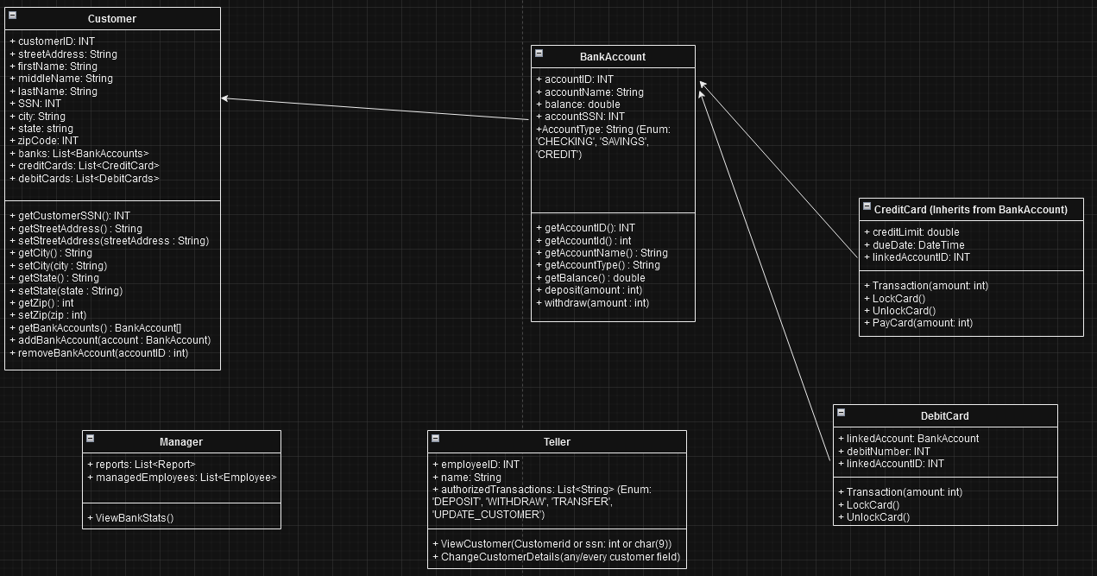
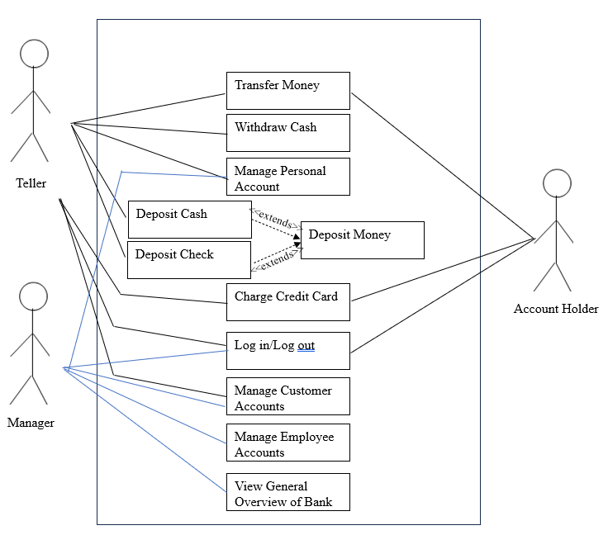
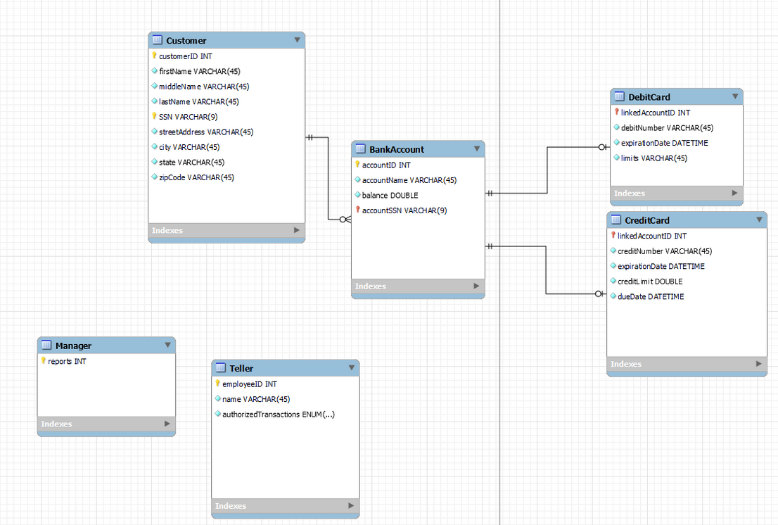
Original UML and Use Case Diagrams

Slide 4
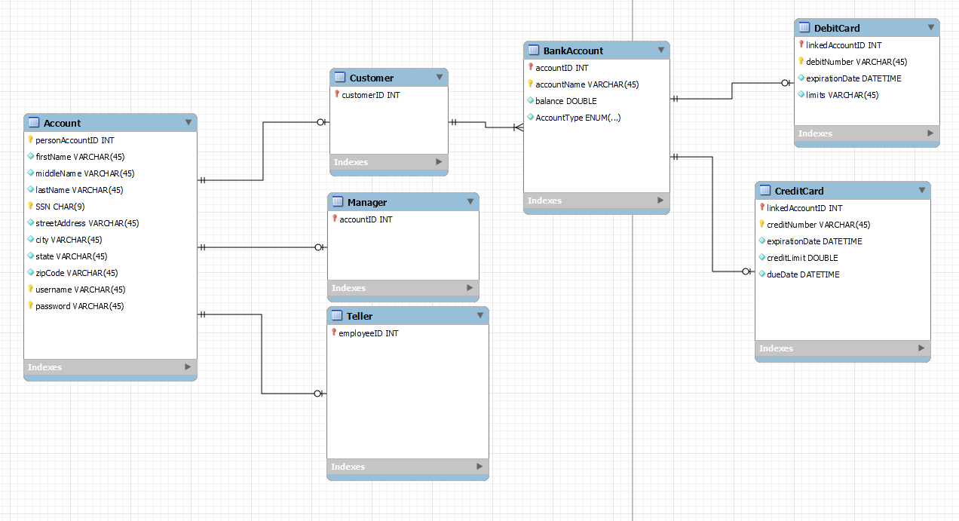
Database Schema

Slide 5
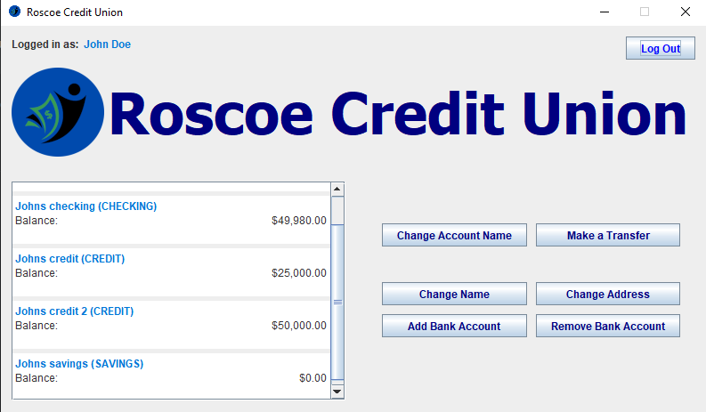
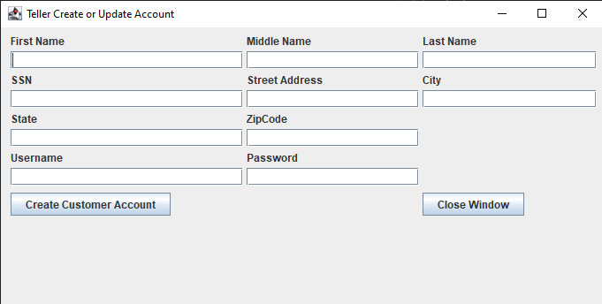
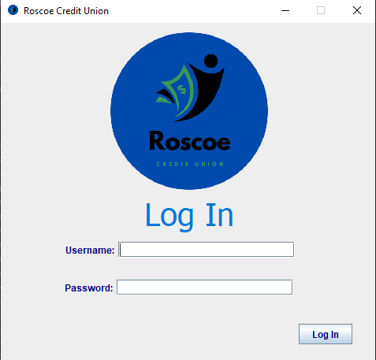
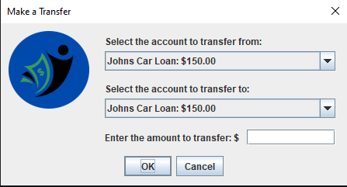
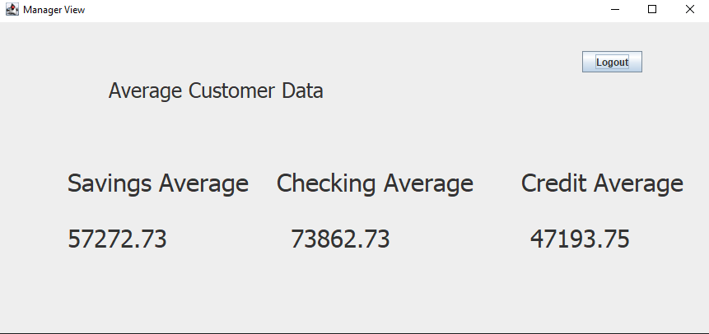
Application

Slide 6
areas of growth
We had planned on an ATM functionality but never got that far.
For the design, we went with high fidelity for the customer view, but low and clunky views for the Manager and Teller as they are more likely trained on the software, and we need more time to add more features to the Tellers and Managers.
Security is an issue as we don’t believe our code protects against database attacks at all from a customer, as well as having public methods that could be reached in the customer view.
Usernames and Passwords are not Hashed, they are stored directly and therefore pose as a security risk.

Slide 7
ASK QUESTIONS
Thank You from
Roscoe Patnode and Robbie McGough
Roscoe Credit Union

